Slide 1
6 The Transport Layer

Slide 2
Highlights
Transport service
Elements of transport protocols
Addressing
Connection
Flow Control
Congestion control
The Transport Layer in Internet UDP/TCP
connection management
window management
congestion management

Slide 3
6.1 The Transport Service

Slide 4
The Transport Service
Transport layer is the heart of the whole protocol hierarchy
It provides reliable data transport end to end (ETE)
It masks the diversity of communication subnets, provide a common interface to the upper layer
It fulfills the key function of isolating the upper layers from the technology, design, and imperfections of the subnet
It provides multiple SAPs sharing one network link

Slide 5
The Transport Function
应用进程
应用进程
AP₄
AP₁
AP₂
AP₃
5
4
3
2
1
5
4
3
2
1
端口
端口
传输层提供应用进程间的逻辑通信
IP 层
主机 A
主机 B
AP₁
路由器 1
路由器 2
AP₃
LAN₁
WAN
LAN₂
AP₂
AP₄
IP 协议的作用范围
传输层协议 TCP 和 UDP 的作用范围

Slide 6
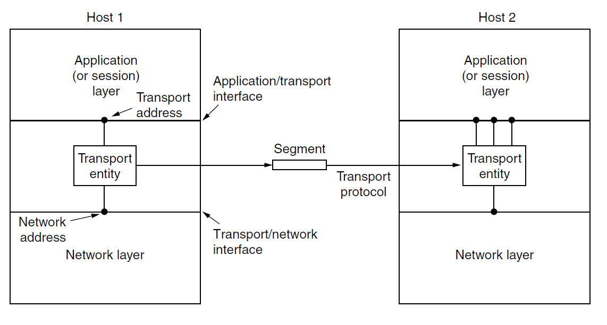
Network, transport, application layers
There are two types of network service, connection-oriented and connectionless, there are also two types of transport service. If the transport layer service is so similar to the network layer service, why are there two distinct layers? Why is one layer not adequate?

Slide 7
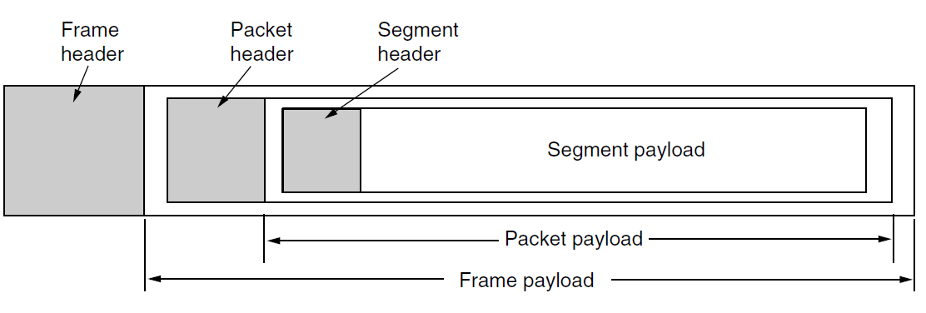
Nesting of segment, packet, and frame
TPDU（Transport Protocol Data Units ）= Segment

Slide 8
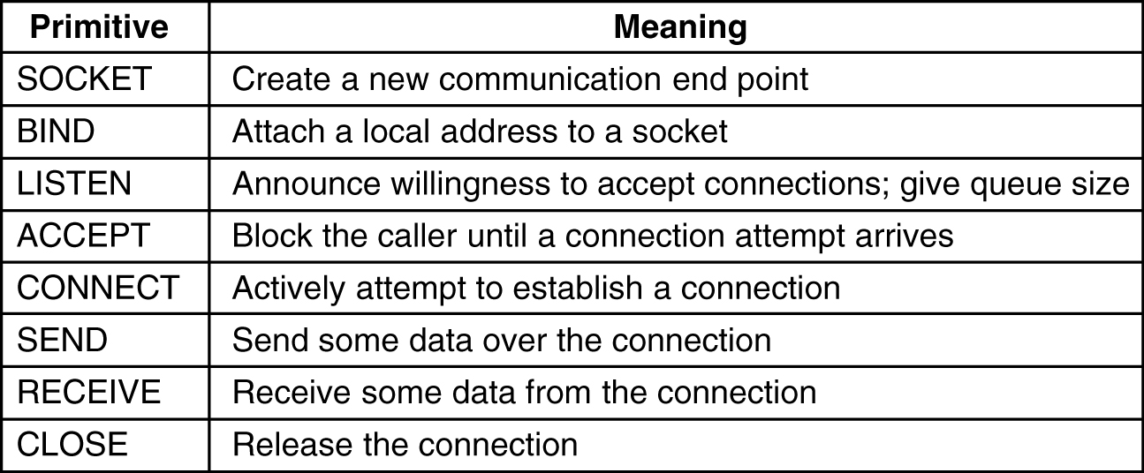
Berkeley Sockets

Slide 9
Client
int main()
{
int sock, bytes;
char buf[4096]; /* buffer for incoming file */
struct sockaddr_in server; /* Server’s SAP */
sock = socket(PF_INET, SOCK_STREAM, IPPROTO_TCP);
server.sin_family= AF_INET;
server.sin_addr.s_addr = inet_addr("192.168.0.176"); /* server’s address */
server.sin_port= htons(12345);
connect(sock, &server, sizeof(server));
write(sock, ”abc.txt”, 8);
/ * Go get the file and write it to standard output. */
for(;;) {
bytes = read(sock, buf, sizeof(buf)); /* read from socket */
if (bytes <= 0) exit(0); /* check for end of file */
write(1, buf, bytes); /* write to standard output */
}
}

Slide 10
Server
int main()
{
int fd, sock, data_sock, bytes;
char buf[4096];
struct sockaddr_in server， peer;
server.sin_family = AF_INET;
server.sin_addr.s_addr = htonl(INADDR_ANY);
server.sin_port = htons(12345);
sock = socket(AF_INET, SOCK_STREAM, IPPROTO_TCP);
bind(sock, &server, sizeof(server));
listen(sock, 5);
for(;;) {
data_sock = accept(sock, &peer, sizeof(peer)); /* block for connection request */
read(data_sock, buf, sizeof(buf)); /* read file name from socket */
fd = open(buf, O_RDONLY); /* open the file to be sent back */
for(;;) {
bytes = read(fd, buf, sizeof(buf)); /* read from file */
if (bytes <= 0) break; /* check for end of file */
write(data_sock, buf, bytes); /* write bytes to socket */
}
close(fd); /* closefile */
close(data_sock); /* close connection */
}
}

Slide 11
6.2 Elements of Transport Protocols

Slide 12
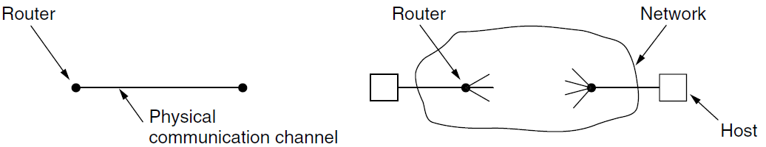
Transport Protocol & Data Link Protocol
Both have to deal with error control, sequencing, flow control
Environment differences
Addressing of destinations
Initial connection establishment
Storage capacity in the subnet
Allocation of buffers
a large and varying number of connections with bandwidth that fluctuates as the connections compete with each other

Slide 13
Elements of Transport Protocols
Addressing
Connection Establishment
Connection Release
Flow Control and Buffering

Slide 14
Addressing

Slide 15
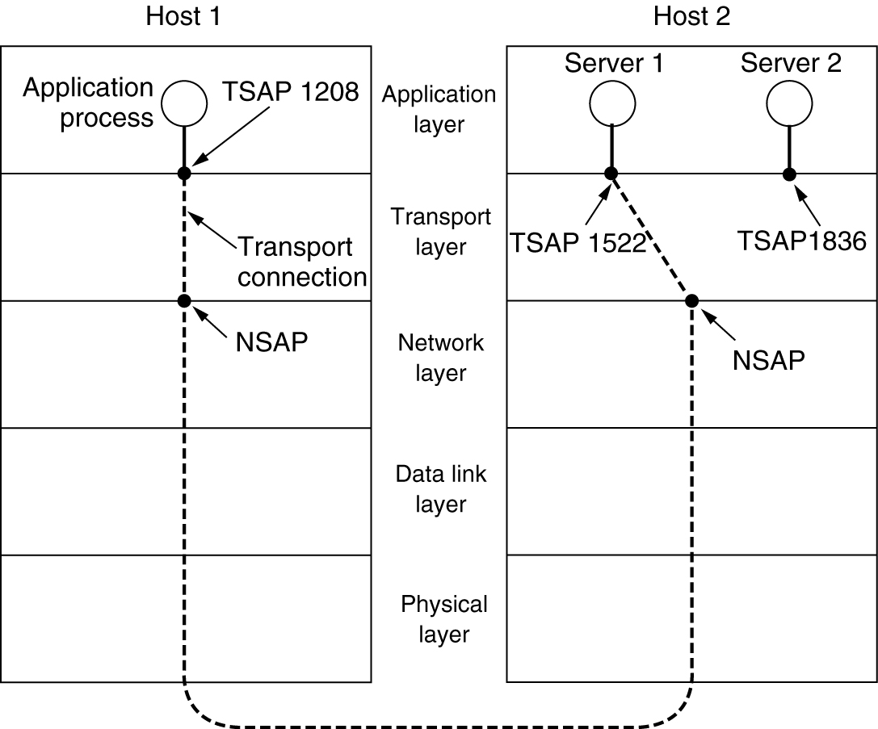
Addressing
TSAPs, NSAPs and transport connections.

Slide 16
Addressing
Gets the Server’s TSAP
Well-known TSAP
Look up a name server or directory server
Process server
If there are many server processes, most of which are rarely used, it is wasteful to have each of them active (inetd)

Slide 17
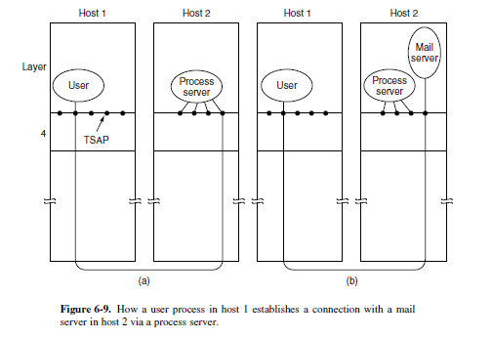
Process Server

Slide 18
Connection Establishment

Slide 19
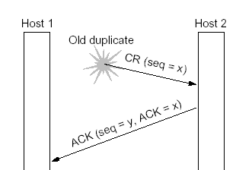
Problem
Establishing a connection sounds easy
One sends a CONNECTION REQUEST TPDU to the destination and wait for a CONNECTION ACCEPTED reply
Problems
Network can lose, store, and duplicate packets
The connection establishment TPDU could be delayed or duplicated

Slide 20
Solution
Using throwaway transport addresses
Giving each connection a ID, but a crashed machine can not know which identifier have been used
Each connection starts numbering its segments with a different initial sequence number (the low-order k bits of the clock)
Require transport entities to be idle for T sec after a recovery to let all old segments die off
Prevent sequence numbers from being reused for a time T before their potential use as initial sequence numbers

Slide 21
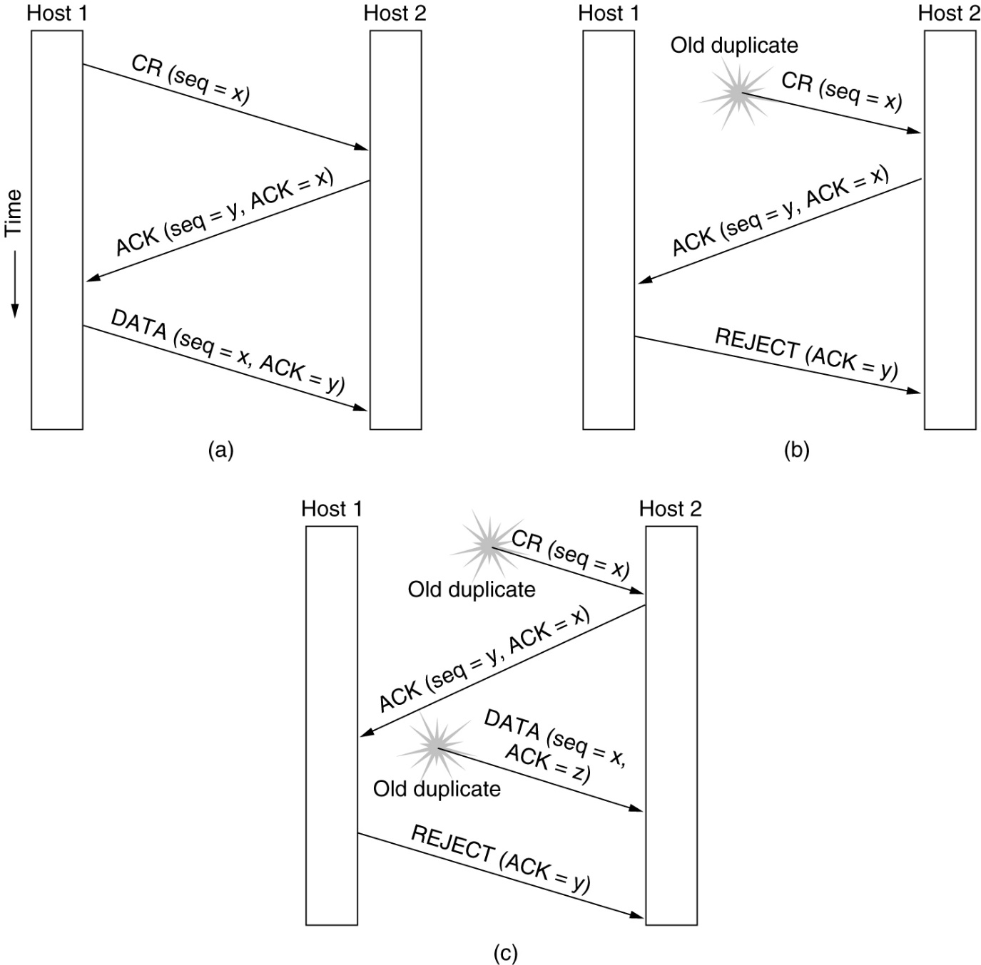
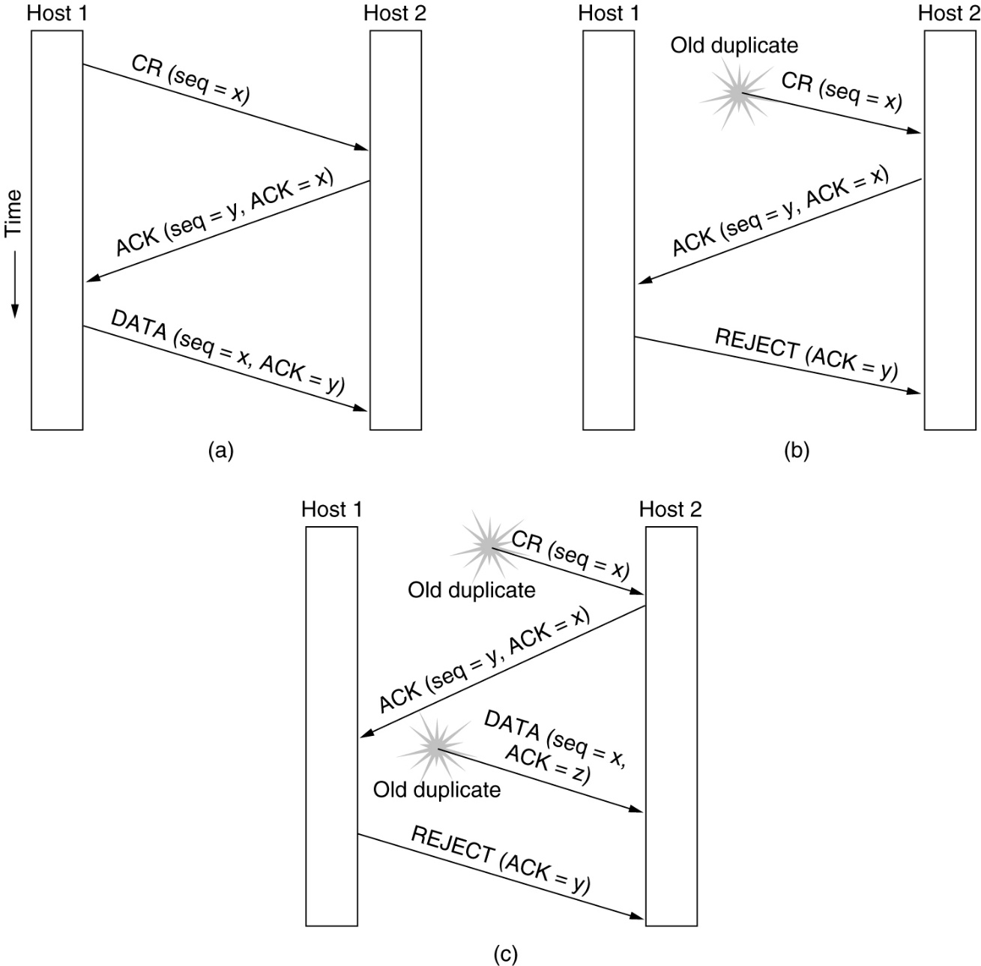
The Three-way Handshake
CR: Connect Request
Three protocol scenarios for establishing a connection using a three-way handshake
(a) Normal operation
(b) Old CONNECTION REQUEST appearing out of nowhere
(c) Duplicate CONNECTION REQUEST and duplicate ACK

Slide 22
Connection Release

Slide 23
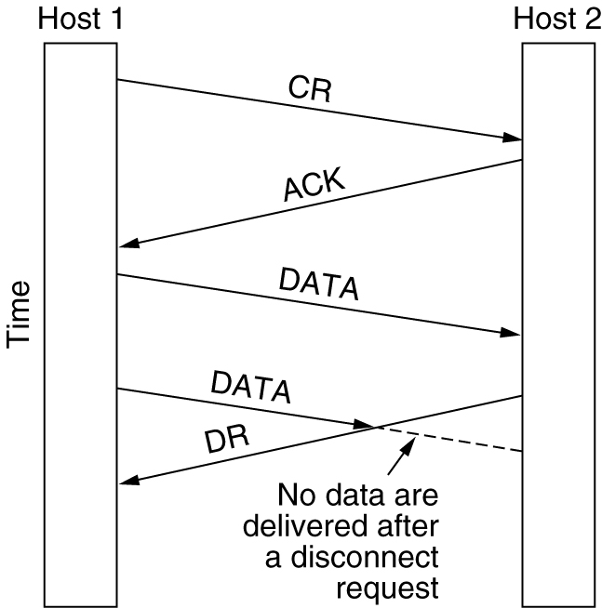
Two Styles
Asymmetric Release (violent)
when one party hangs up, the connection is broken
Asymmetric release is abrupt and may result in data loss
Symmetric Release (graceful)
Treats connection as two separate unidirectional connections
Requires each one to be released separately
CR: Connect Request

Slide 24
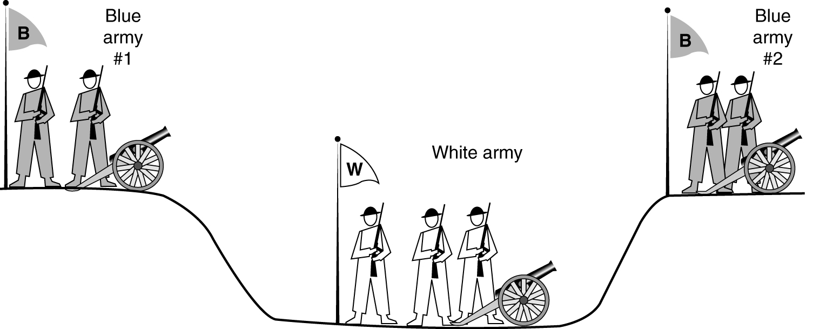
The Two-army Problem

Slide 25
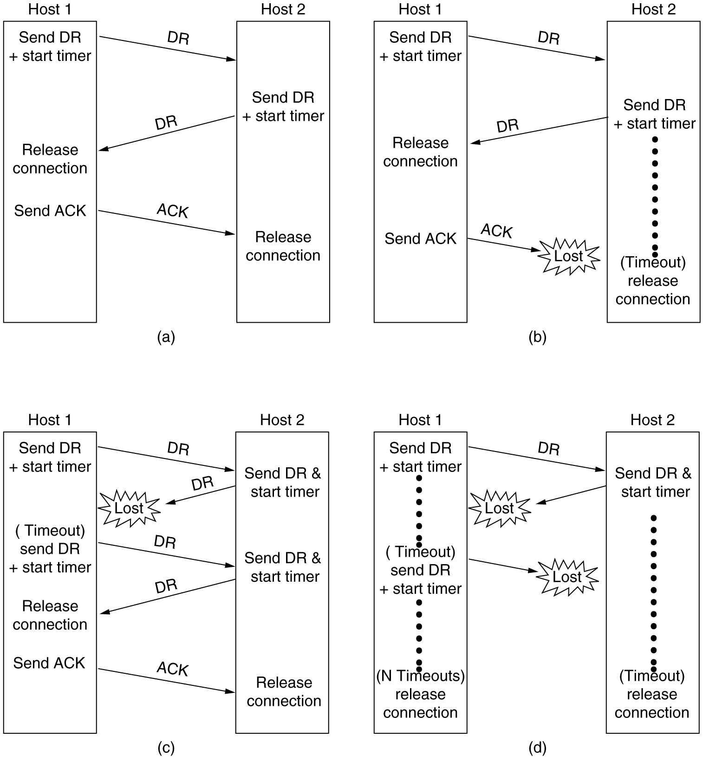
Connection Release
Releasing a connection means
The transport entity removes the information about the connection from its table of currently open connections and signals the connection's owner (the transport user) somehow
(Disconnect Request)
(a) Normal case of a three-way handshake. (b) final ACK lost.

Slide 26
Connection Release
(c) Response lost (d) Response lost and subsequent DRs lost

Slide 27
Connection Release: Half-open Connections
Half-open connection
if the initial DR and N retransmissions are all lost. The sender will give up and release the connection, while the other side knows nothing at all about the attempts to disconnect
Kill off half-open connections
If no TPDUs have arrived for a certain number of seconds, the connection is then automatically disconnected
Dummy TPDU: just to keep the other side from disconnecting (keepalive, heartbeat)

Slide 28
Error Control
and Flow Control

Slide 29
Error Control
Error-detecting code (e.g., a CRC or checksum)
ARQ (Automatic Repeat reQuest)：
Stop-and-wait
sliding window protocol

Slide 30
Source Buffering & Destination Buffering
The optimum buffering between source buffering and destination buffering
Buffering at sender
Buffering at receiver
Variable sized windows: Dynamic buffer management
The sender and receiver need to dynamically adjust their buffer allocations
The receiver piggybacks both acknowledgements and buffer allocations onto the reverse traffic
Decouple buffering from acknowledgments

Slide 31
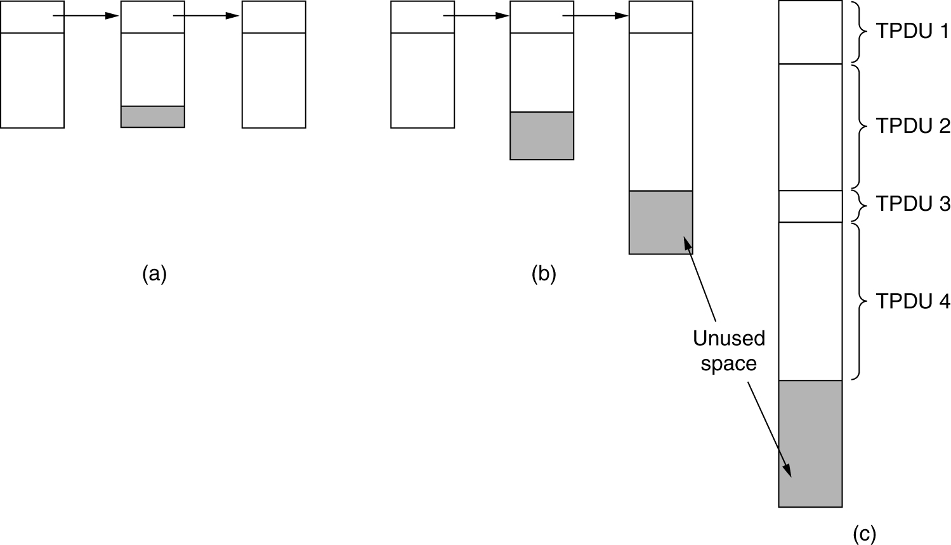
Buffer Size Problem
(a) Chained fixed-size buffers. (b) Chained variable-sized buffers. (c) One large circular buffer per connection.

Slide 32
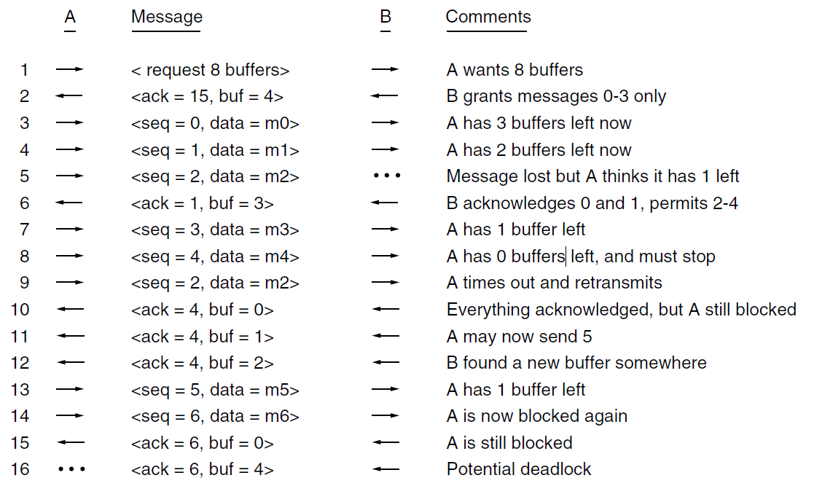
Dynamic buffer allocation

Slide 33
Flow Control
Two flow control factor
Buffer space available in the receiver
explicit window indication
The capacity of the subnet
sender monitor the network’s carrying capacity

Slide 34
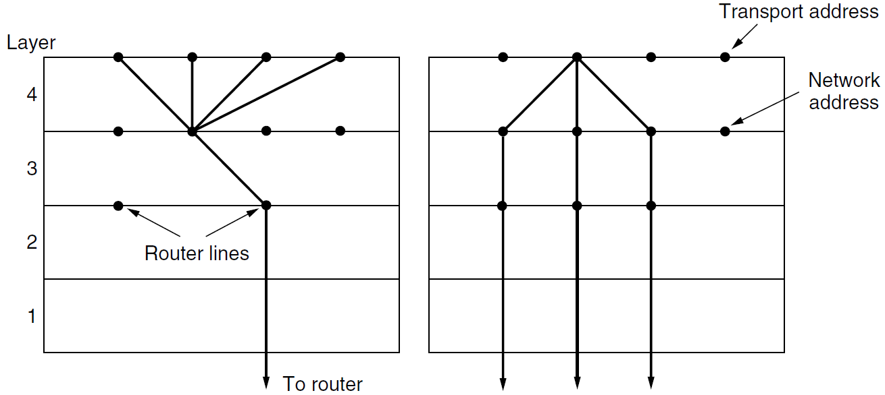
Multiplexing
(a) Multiplexing. (b) Inverse multiplexing(SCTP)

Slide 35
6.3 Congestion Control

Slide 36
Desirable Bandwidth Allocation

Slide 37
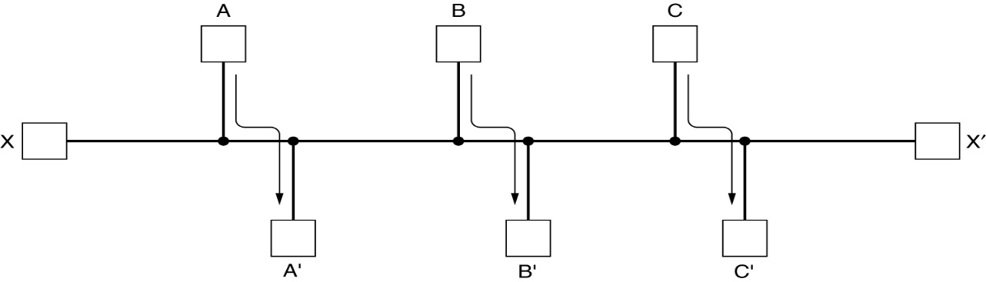
Congestion Control
Responsibility of the network and transport layers
Congestion occurs at routers, so it is detected at the network layer
The only effective way is for the transport protocols to send packets into the network more slowly
Internet relies heavily on the transport layer for congestion control (TCP)
Goal of Congestion Control Algorithm
Avoid congestion
Find a good allocation of bandwidth to use all the available bandwidth (Efficiency)
Be fair across competing transport entities (Fairness)
Quickly track changes in traffic (Convergence)

Slide 38
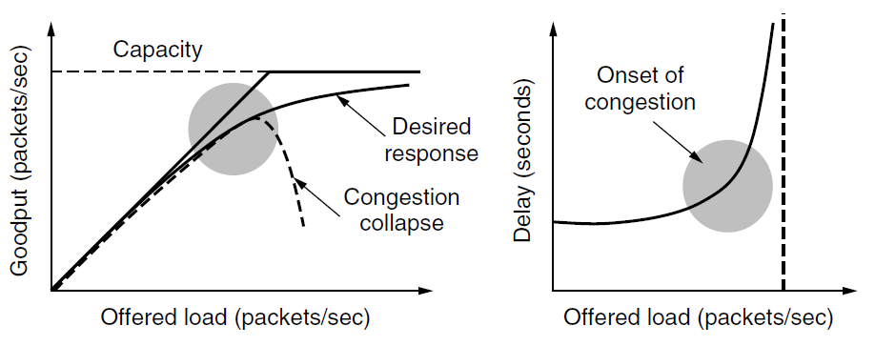
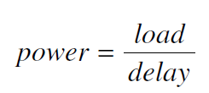
Efficiency and Power
The load with the highest power represents an efficient load for the transport entity to place on the network

Slide 39
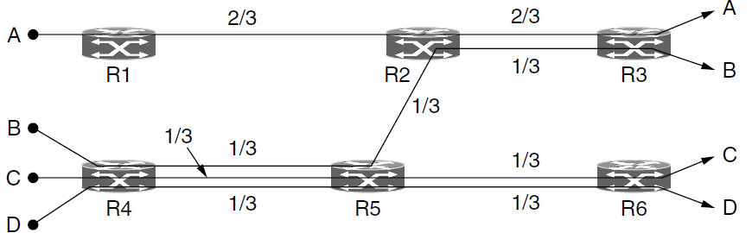
Max-Min Fairness
How to divide bandwidth between transport senders
Networks do not have a strict bandwidth reservation for each flow or connection
IP routers often have all connections competing for the same bandwidth
Max-min fairness
If the bandwidth given to one flow cannot be increased without decreasing the bandwidth given to another flow with an allocation that is no larger

Slide 40
Examples

Slide 41
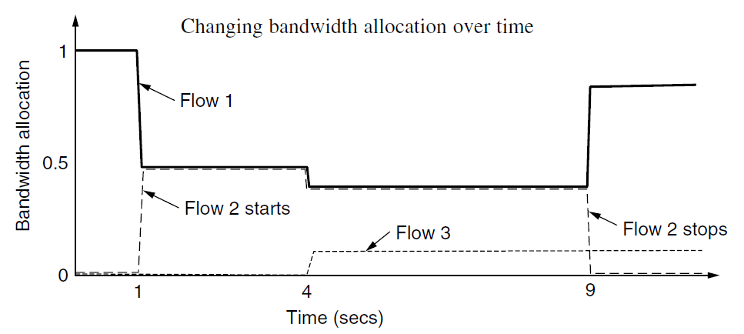
Convergence
Converge quickly to a fair and efficient allocation of bandwidth
The ideal operating point for the network varies over time
The algorithm should rapidly converge to the ideal operating point, and it should track that point as it changes over time

Slide 42
Regulating the Sending Rate

Slide 43
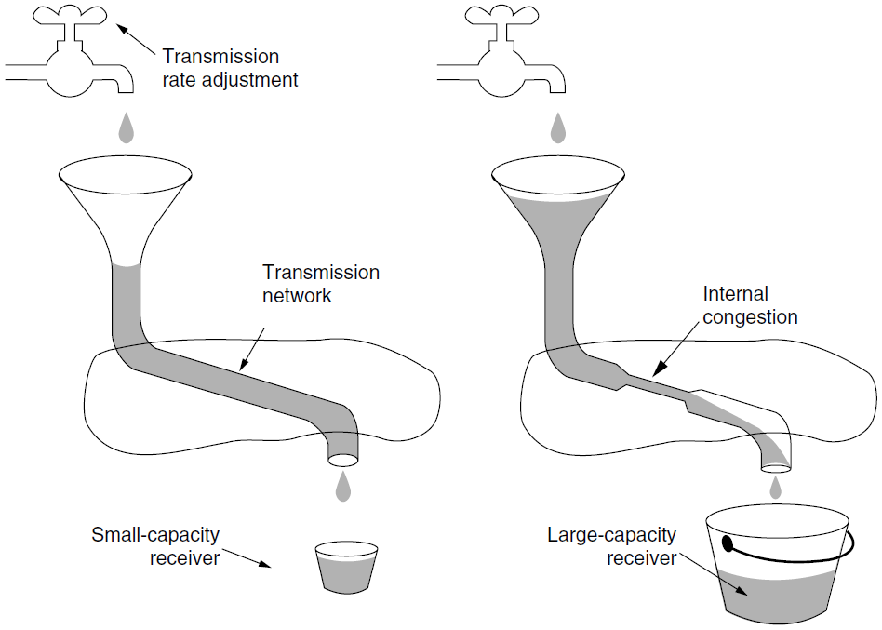
Sending Rate Limited by 2 Factors
Flow control & Congestion

Slide 44
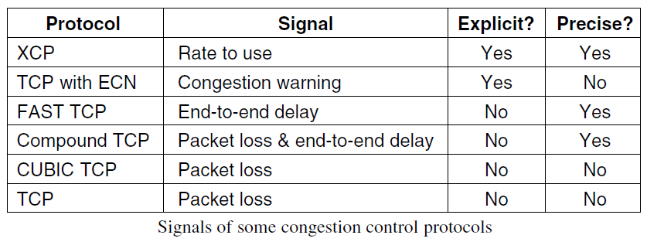
Feedback from Network
If an explicit and precise signal is given
Use the signal to adjust rate to the new operating point
In the other cases (the control law)
No congestion signal, senders should increase their rates
When a congestion signal is given, senders should decrease their rates

Slide 45
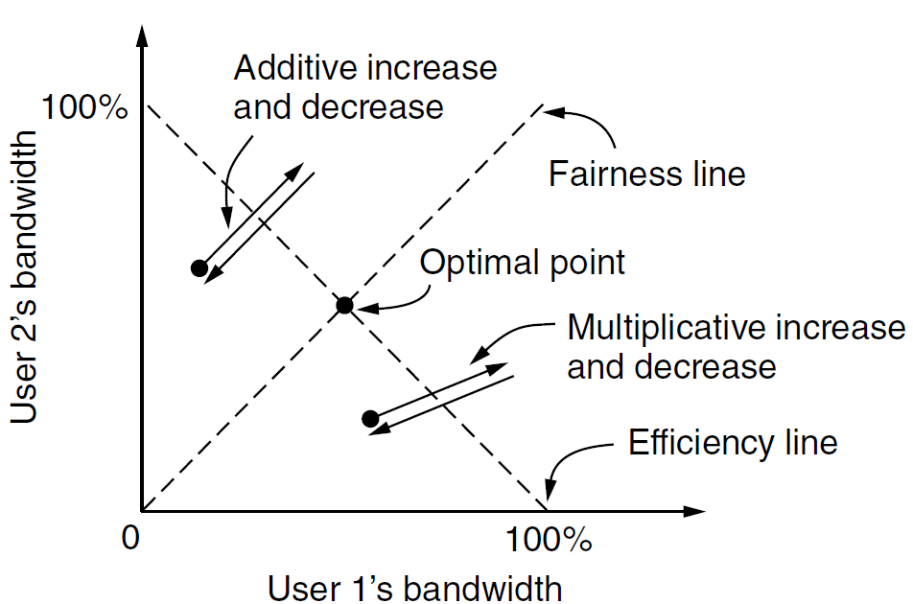
Additive and Multiplicative Bandwidth Adjustments

Slide 46
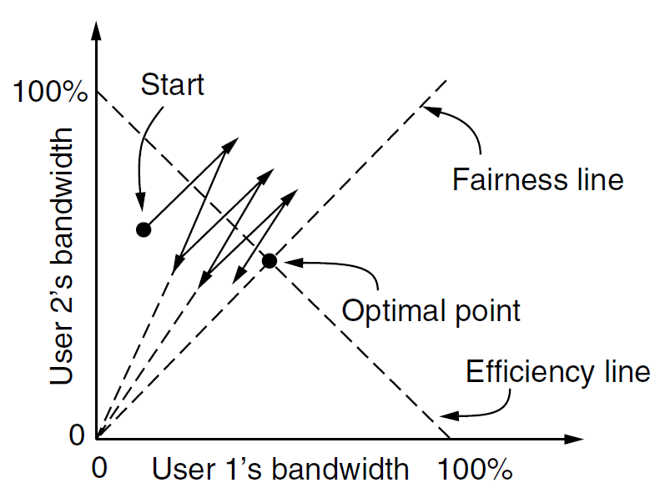
AIMD Control Law
AIMD(Additive Increase Multiplicative Decrease) does converge to optimal point both fair and efficient

Slide 47
AIMD is Used by TCP
Not adjusting the rate directly, a strategy used in practice is to adjust the size of a sliding window
If the window size is W and the round-trip time is RTT, the equivalent rate is W/RTT
Be easy to combine with flow control, which already uses a window, and has the advantage that the sender paces packets using acknowledgements
Not quite fair: different connections have different RTTs, this leads to a bias in which connections to closer hosts receive more bandwidth than connections to distant hosts
TCP-friendly congestion control in non-TCP transport protocols
There is significant community pressure for new transport protocols to be designed so that they compete fairly with TCP

Slide 48
6.4 The Internet Transport Protocols

Slide 49
UDP
(User Datagram Protocol)

Slide 50
The Internet Transport Protocols
TCP (Transmission Control Protocol)
RFC793
Connection-oriented protocol
Byte-stream
UDP (User Datagram Protocol)
RFC768
Connectionless Protocol
Application
TCP UDP
IP
Host-to-Network
TCP/IP Protocol Stack

Slide 51
UDP (User Datagram Protocol)
Does not do flow control, error control, or retransmission upon receipt of a bad segment
Provide an interface to the IP protocol with the added feature of demultiplexing multiple processes using the ports
Broadcast & Multicast
User datagram boundary

Slide 52
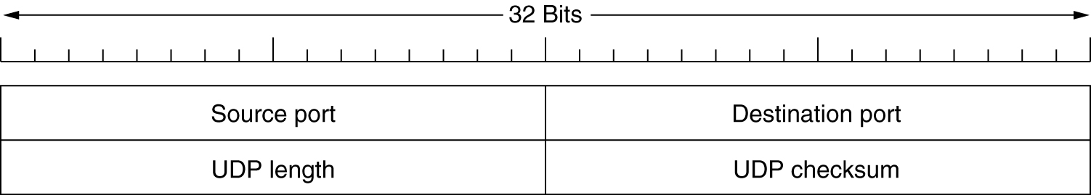
UDP Header
Checksum
Optional: Stored as 0 if not computed (a true computed 0 is stored as all 1s)
The checksum algorithm is simply to add up all the 16-bit words in one’s complement and to take the one’s complement of the sum
Including header、data and the pseudoheader in the UDP checksum computation helps detect misdelivered packets

Slide 53
UDP Checksum
字节
4
4
1
1
2
源 IP 地址
目的 IP 地址
0
17
UDP长度
字节
12
2
2
2
2
伪首部
源端口
目的端口
长 度
检验和
UDP 用户数据报
首 部
数 据
发送
首 部
数 据
IP 数据报

Slide 54
UDP Applications
DNS (Domain Name System)
DHCP (Dynamic Host Configuration Protocol)
RIP (Routing Information Protocol)
RTP (Real-time Transport Protocol)
TFTP (Trivial File Transfer Protocol)
RPC (Remote Procedure Call)
NFS (Net File System)
P2P (Peer-to-Peer, DHT, ‘Kademlia’)

Slide 55
TCP
(Transmission Control Protocol)

Slide 56
The TCP Service Model
Socket
socket address: IP address and Port (16-bit, TSAP)
Each connection is identified by a pair of sockets
Well-known ports
Reserved for standard services
RFC1700
‘inetd’ process (Internet daemon)
TCP connection
Full-duplex
End-to-End
TCP does not support multicasting or broadcasting
Byte-stream, not message stream (Why?)
Message boundaries are not preserved end to end, just like UNIX file

Slide 57
TCP Well-known ports

Slide 58
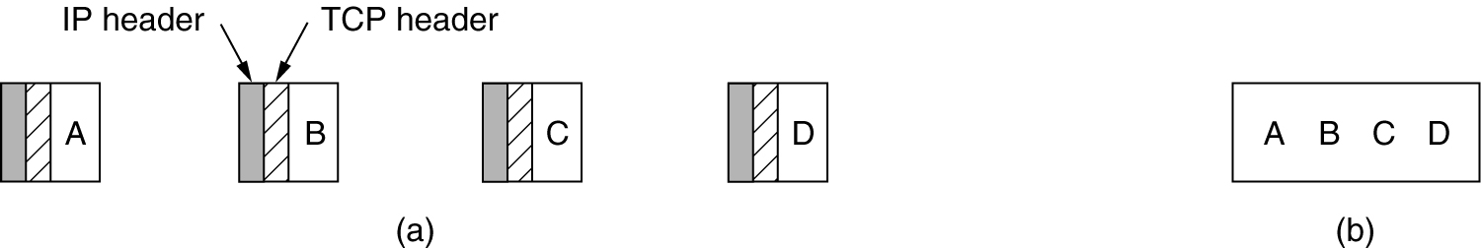
TCP Byte-stream
(a) Four 512-byte segments sent as separate IP datagrams.
(b) The 2048 bytes of data delivered to the application in a single READ CALL
PUSH flag
To force data out, applications can use the PUSH flag, which tells TCP not to delay the transmission
Urgent data

Slide 59
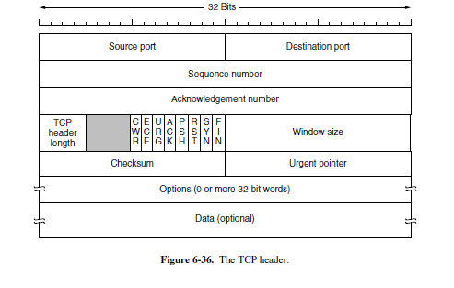
TCP Segment Header

Slide 60
TCP Protocol (1)
TCP Entity
A port plus its host's IP address forms a 48-bit unique end point
The source and destination end points together identify the connection
(Local IP, Local port, Peer IP, Peer Port)
32-bits sequence
Count byte, not segment (network speeds ，56k/1week)
sequence numbers, acknowledgements number
TCP sender can accumulate data from several writes into one segment or can split data from one write over multiple segments
The retransmissions may include different byte ranges than the original transmission

Slide 61
TCP Protocol (2)
TCP Segment
20 or more bytes head, n bytes data
Segments without any data are legal and are commonly used for ACK and control messages
MSS (Maximum Segment Size)
Limited by IP datagram length
Limited by MTU of each data link, so router could fragment a segment
Variable sized sliding window
Reorder the segment
Disordered and duplicated segments received by the receiver

Slide 62
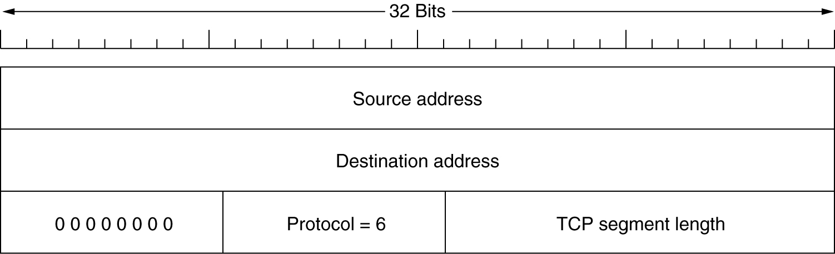
The TCP checksum
TCP Checksum
It checksums the header, the data, and the conceptual pseudoheader
Pseudoheader: helps detect misdelivered packets
Checksum is mamdatory
The pseudoheader included in the TCP checksum

Slide 63
TCP Options
MSS option
Allow hosts to specify the maximum TCP payload it is willing to accept
During connection setup, each side can announce its maximum and see its partner's
If a host does not use this option, it defaults to a 536-byte payload
The maximum segment size in the two directions need not be the same
Window scale option
Allow the sender and receiver to negotiate a window scale factor
Selective repeat instead of go back n protocol
NACK: RFC 1106 introduced NAKs to allow the receiver to ask for a specific segment
Selective Acknowledgment (SACK)
Timestamp option
The PAWS (Protection Against Wrapped Sequence numbers)

Slide 64
Notes:
————
Kind
(Type)
Length
Name
Reference
描述 & 用途
0
1
EOL
RFC 793
选项列表结束
1
1
NOP
RFC 793
无操作（用于补位填充）
2
4
MSS
RFC 793
最大Segment长度
3
3
WSOPT
RFC 1323
窗口扩大系数（Window Scaling Factor）
4
2
SACK-Premitted
RFC 2018
表明支持SACK
5
可变
SACK
RFC 2018
SACK Block（收到乱序数据）
8
10
TSPOT
RFC 1323
Timestamps
19
18
TCP-MD5
RFC 2385
MD5认证
28
4
UTO
RFC 5482
User Timeout（超过一定闲置时间后拆除连接）
29
可变
TCP-AO
RFC 5925
认证（可选用各种算法）
253/254
可变
Experimental
RFC 4727
保留，用于科研实验

Slide 65
TCP Connection Establishment
Client
Executes a CONNECT primitive, specifying the IP address and port, sends a TCP segment with the SYN bit on and ACK bit off and waits for a response
Server
When client’s SYN segment arrives, checks to see if there is a process that has done a LISTEN on the port
If not, it sends a reply with the RST bit on to reject the connection
If some process is listening to the port, that process is given the incoming TCP segment, ......

Slide 66
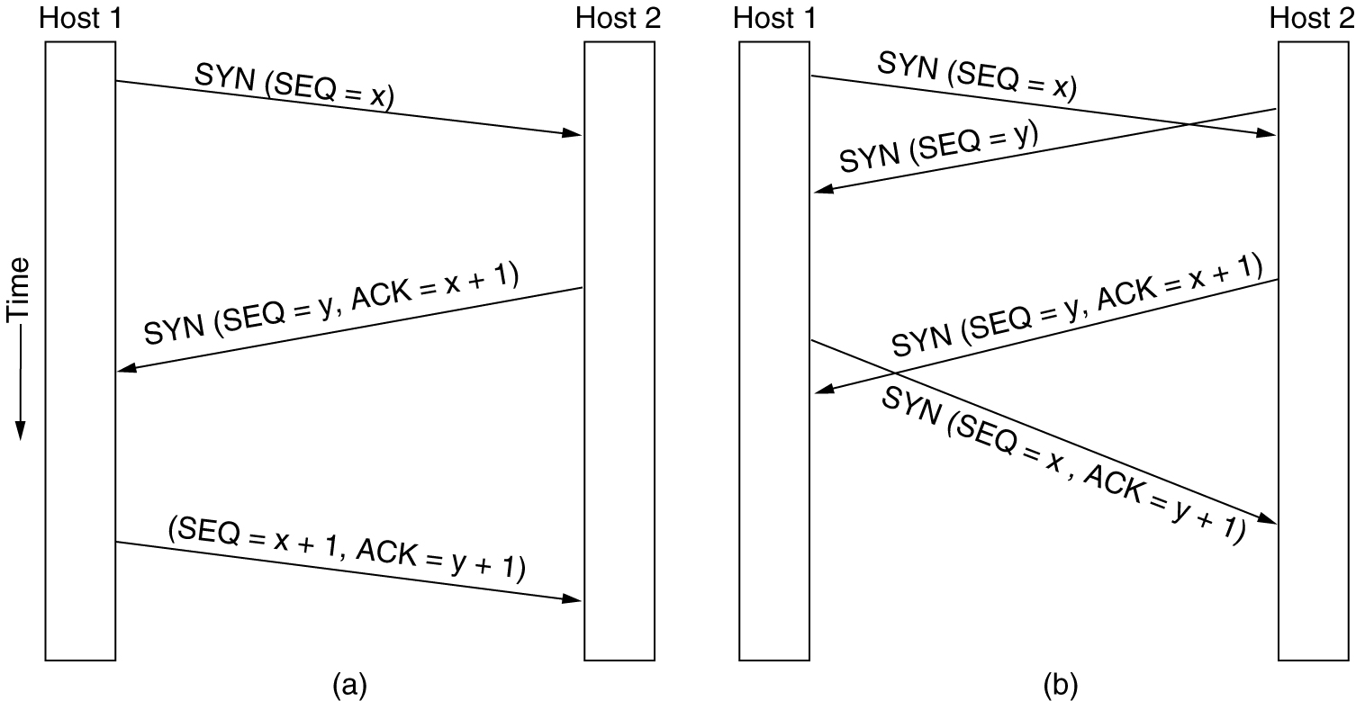
TCP Connection Establishment
(a) TCP connection establishment in the normal case.
(b) Simultaneous connection establishment on both sides.

Slide 67
Initial Sequence Number
Initial sequence number
A clock-based scheme is used, with a clock tick every 4 µsec
When a host crashes
It may not reboot for the maximum packet lifetime to make sure that no packets from previous connections are still roaming around the Internet somewhere

Slide 68
TCP Connection Release
Host 1
Host 2
Application request releasing connection
FIN=1, Seq=x
Notify application
Ack= x+1
Application request releasing connection
FIN=1, Seq= y
Notify application
Ack= y+1
Release the whole connection
Use timer to avoid the two-army problem
If a response to a FIN is not forthcoming within two maximum packet lifetimes, the sender of the FIN releases the connection

Slide 69
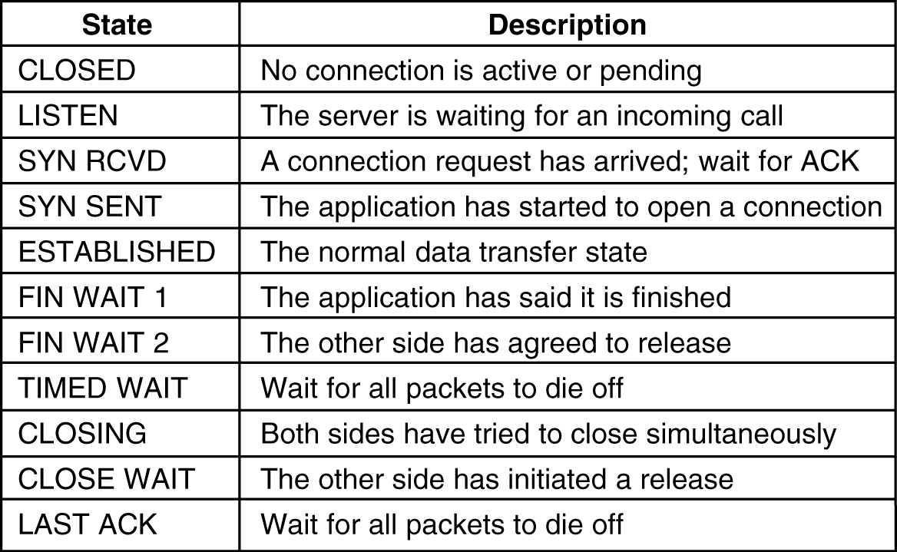
TCP Connection Management Modeling
States used in the TCP connection management finite state machine

Slide 70
TCP Finite State Machine

Slide 71
TCP Finite State Machine

Slide 72
TCP Connection Establishment

Slide 73
TCP Connection Release (1)

Slide 74
TCP Connection Release(2)

Slide 75
TCP Connection Release (3)

Slide 76
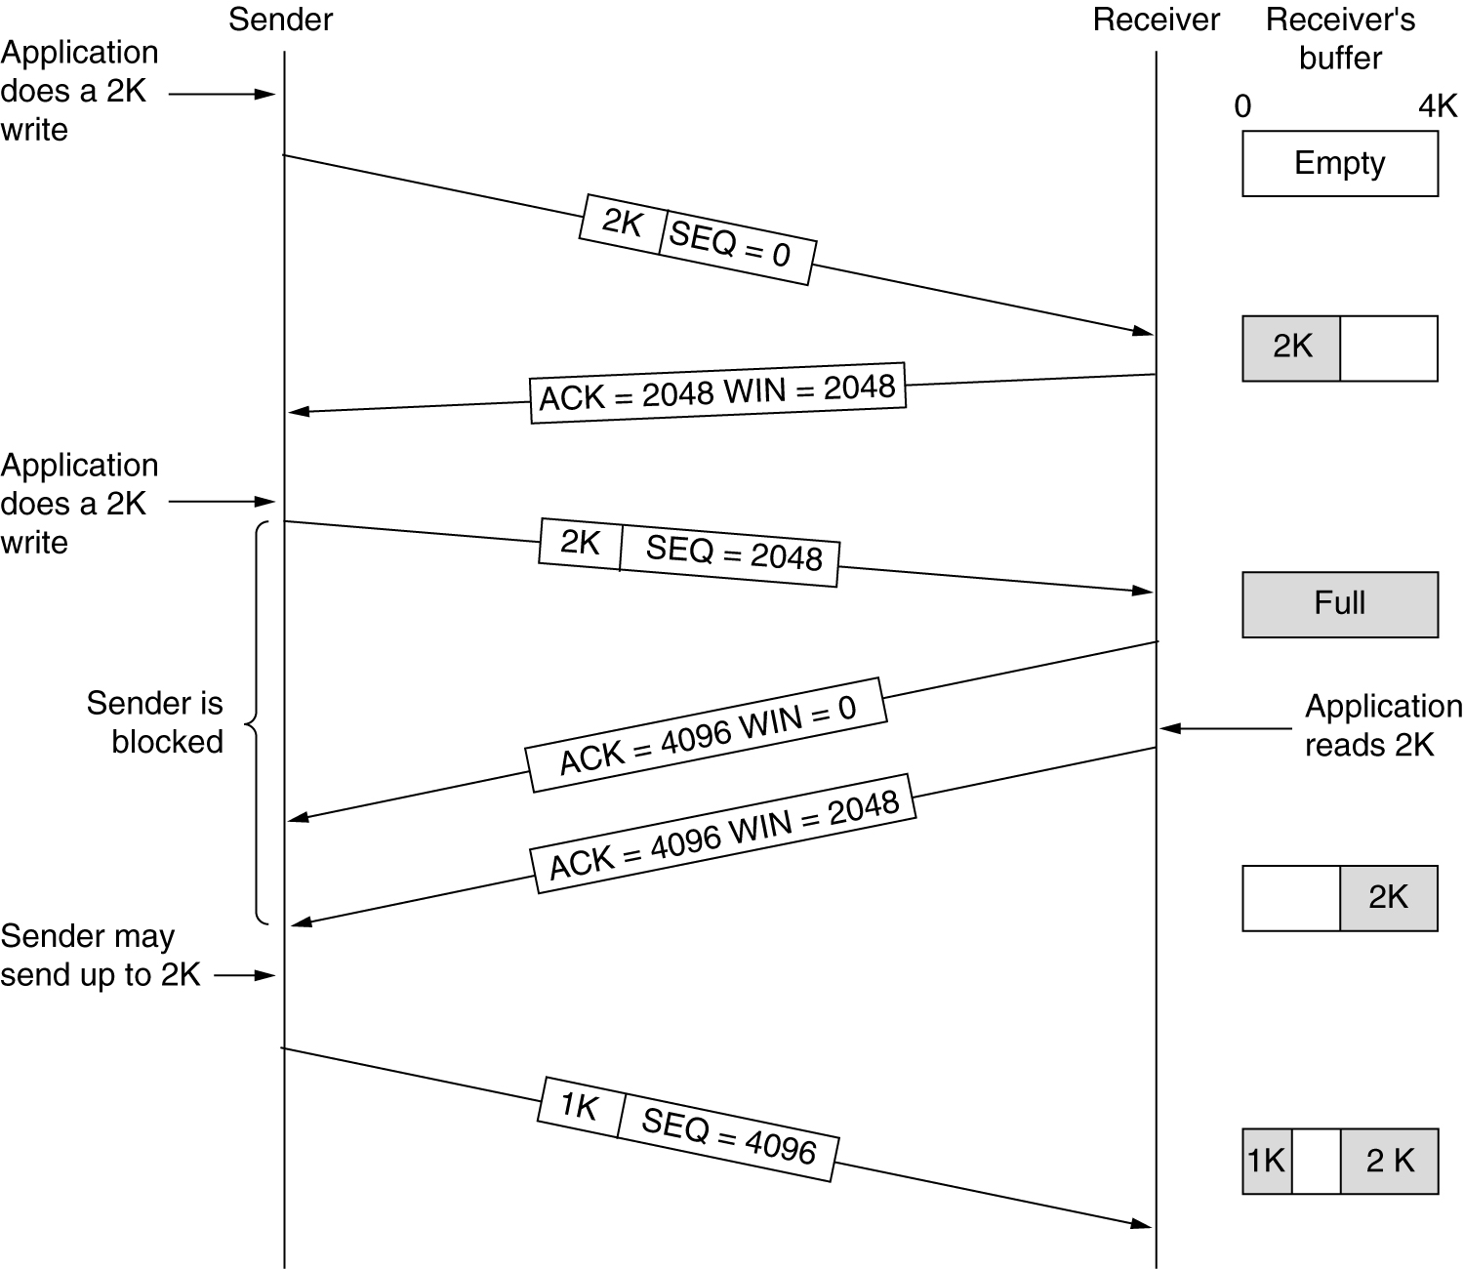
Window management in TCP

Slide 77
Window management in TCP
When the window is 0
Sender may not normally send segments
Urgent data may be sent
Sender may re-send a 1-byte segment to probe ACK & window to prevent deadlock

Slide 78
Nagle’s algorithm
Problem
Overhead: TCP head + IP head=20+20 bytes
When used in TELNET connection, 1 data bytes carried with 40 bytes overhead
(41+40+40+41)(DATA+ACK+WIN+ECHODATA)
Improvement algorithm
Receiver: Delay acknowledgement and window update, reduce the load placed by the receiver
Sender: Nagle’s algorithm
Send one segment unless either of the following condition exist:
Acknowledgement to last segment has been received
Buffered data fills half the window or a maximum segment
TCP Option
TCP_NODELAY: Disable Nagle’s algorithm & using PUSH bit
Linux TCP_CORK: Disable Nagle’s algorithm, wait 200ms to accumulate data for sending

Slide 79
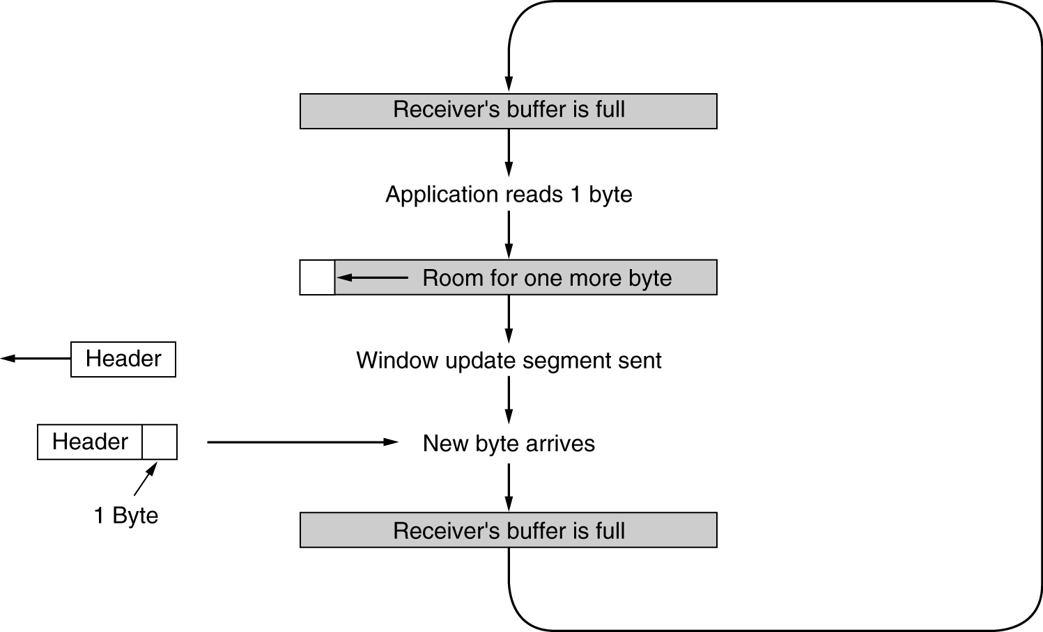
Silly Window Syndrome
Clark’s solution
Receiver should not send a window update until it can handle the MSS or its buffer is half empty, whichever is smaller

Slide 80
Other TCP Policies
Receiver
Buffers received data, blocks a READ request from the application until it has a large chunk of data to provide
About out-of-order segments

Slide 81
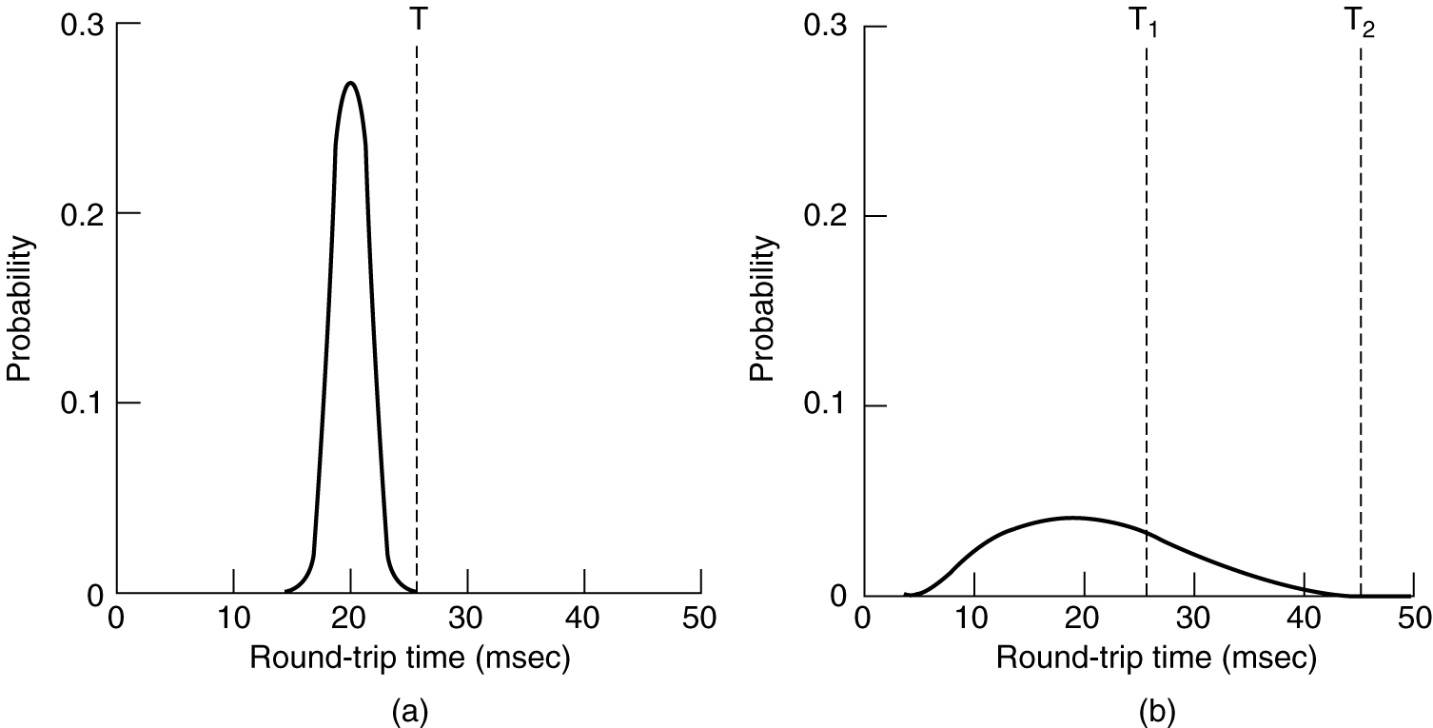
TCP Timer Management
(a) Probability density of ACK arrival times in the data link layer.
(b) Probability density of ACK arrival times for TCP.

Slide 82
Retransmission Timer: Jacobson Algorithm
Solution
Use a dynamic algorithm that adjusts the timeout interval, based on continuous measurements of network performance
Jacobson’s Algorithm
R: How long the successful acknowledgement took
α: A smoothing factor, typically α = 7/8.
RTT: Estimate of the round-trip time
RTT= αRTT+(1-α)R
Timeout interval
Timeout = β RTT , Typically β=2
Enhanced Algorithm
Problem: a constant value was inflexible because it failed to respond when the variance went up
Mean deviation (a cheap estimator of the standard deviation)
RTTVAR= β RTTVAR +(1- β)|RTT-R|, Typically β =3/4
Timeout interval
Timeout = RTT+4 RTTVAR
less than 1% packets come in more than four standard deviations late

Slide 83
Estimate of RTT
RTT= αRTT+(1-α)M, α=7/8
0 | 12.5% | 12.5%
1 | 10.9% | 23.4%
2 | 9.6% | 33.0%
3 | 8.4% | 41.4%
4 | 7.3% | 48.7%
5 | 6.4% | 55.1%
6 | 5.6% | 60.7%
7 | 4.9% | 65.6%
8 | 4.3% | 69.9%
9 | 3.8% | 73.7%
10 | 3.3% | 77.0%
11 | 2.9% | 79.9%
12 | 2.5% | 82.4%
13 | 2.2% | 84.6%
14 | 1.9% | 86.5%
15 | 1.7% | 88.2%
16 | 1.5% | 89.7%
17 | 1.3% | 91.0%
18 | 1.1% | 92.1%
19 | 1.0% | 93.1%
20 | 0.9% | 93.9%
21 | 0.8% | 94.7%
22 | 0.7% | 95.4%
23 | 0.6% | 95.9%
24 | 0.5% | 96.5%
25 | 0.4% | 96.9%
26 | 0.4% | 97.3%
27 | 0.3% | 97.6%
28 | 0.3% | 97.9%
29 | 0.3% | 98.2%

Slide 84
Example RTT estimation (fr-usa)

Slide 85
Retransmission Timer: Karn’s algorithm
Problem
If a segment times out and is sent again, when ACK comes in, it is unclear whether the ACK refers to the first transmission or a later one. Guessing wrong can seriously contaminate the estimate of RTT
Karn’s algorithm
Do not update RTT on any segments that have been retransmitted, instead, the timeout is doubled on each failure until the segments get through the first time

Slide 86
Other TCP Timer
Persistence timer
It is designed to prevent the 0-window deadlock
When timer goes off, the sender transmits a probe to the receiver. The response to the probe gives the window size
Keepalive timer
It is designed to prevent the half-open connection
When a connection has been idle for a long time, the keepalive timer may go off to cause one side to check whether the other side is still there
The timer used in the TIMED WAIT state
Avoid the two-army problem
It runs for twice the maximum packet lifetime to make sure that when a connection is closed, all packets created by it have died off

Slide 87
TCP Congestion Control

Slide 88
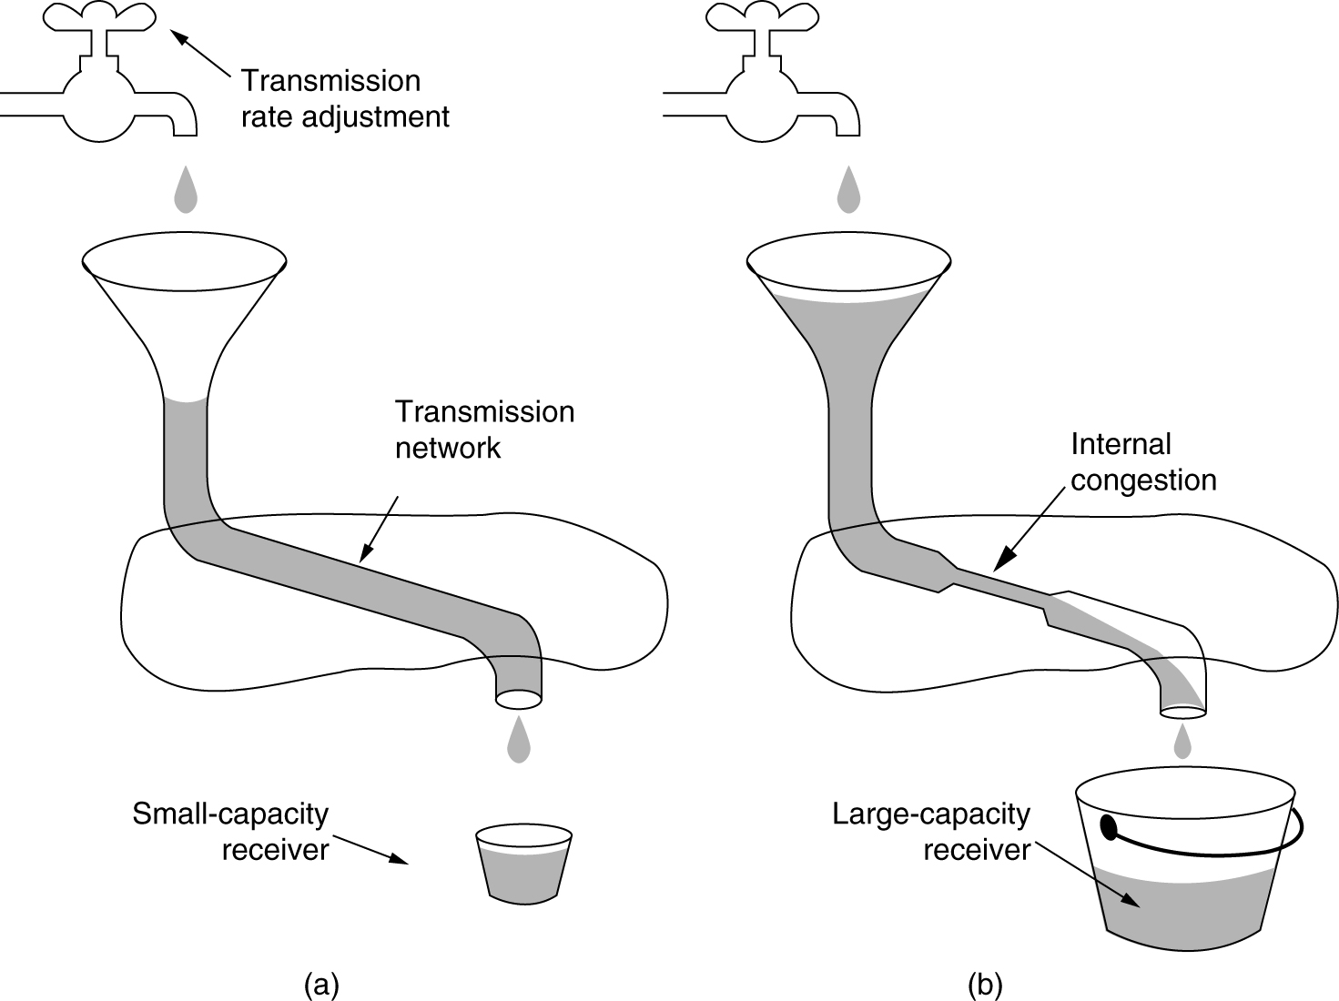
Network capacity and Receiver capacity
(a) A fast network feeding a low capacity receiver
(b) A slow network feeding a high-capacity receiver

Slide 89
TCP Congestion Control
Problem
Starting in 1986, the growing popularity of Internet led to the first occurrence of congestion collapse
New TCP software included congestion control should be able to work with the existing implementation, without changing any of the message formats
Van Jacobson’s Solution
To approximate an AIMD congestion window
TCP maintains a congestion window (cwin) and a flow control window, both are tracked dynamically, the sender window is the smaller of them
Using packet loss as a congestion signal
Depends on transmission errors being relatively rare
This is why 802.11 includes its own retransmission mechanism
A good timer is needed to detect packet loss accurately
The timer includes estimates of the mean and variation in RTT

Slide 90
Two Problems in Practice
The way packets are sent into the network
Must be matched to the network path, otherwise the traffic will cause congestion
Consider a host with a window of 64 KB attached to a 1-Gbps Ethernet, if the host sends the entire window at once, the burst takes 0.5ms, but clogs a 1-Mbps ADSL line in the path for 500ms
The initial congestion windows size
Consider a 10Mbps path with an RTT of 100ms, cwin should be the bandwidth-delay product, 100 packets of 1250 bytes
If cwin starts at 1 packet, increases by 1 packet/RTT, it will be 100 RTTs (10s) before running at the right rate
If starts with a larger initial window, say of 50 packets, the window would be far too large for slow or short links

Slide 91
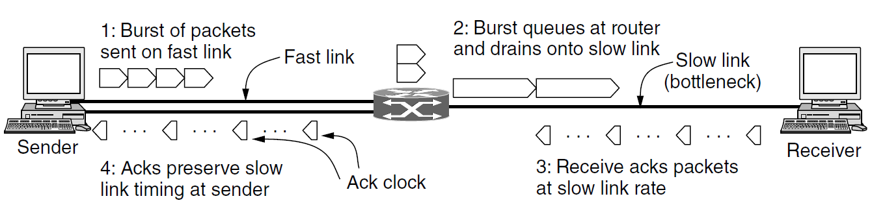
ACK Clock
Using the ACK clock
The times for the ACKs reflect the times at which the packets arrived at the receiver after crossing the slow link
As the ACKs travel over the net and back to the sender, they preserve this timing
If TCP injects packets at the rate of ACKs returned, packets will be sent as fast as the slow link permits, they will not queue up and congest any router along the path
By using an ACK clock, TCP smoothes out traffic and avoids unnecessary queues at routers.

Slide 92
Slow Start
Slow Start
When a connection is established, the cwin is initialized to a value of 1 or 4 segments
The sender sends the initial window, packets will take a RTT to be acknowledged
For each ACK, adds one segment to the cwin (exponential growth)
Performance
Slow-start works well over a range of link speeds and round-trip times, and uses an ack clock to match the rate of sender transmissions to the network path

Slide 93
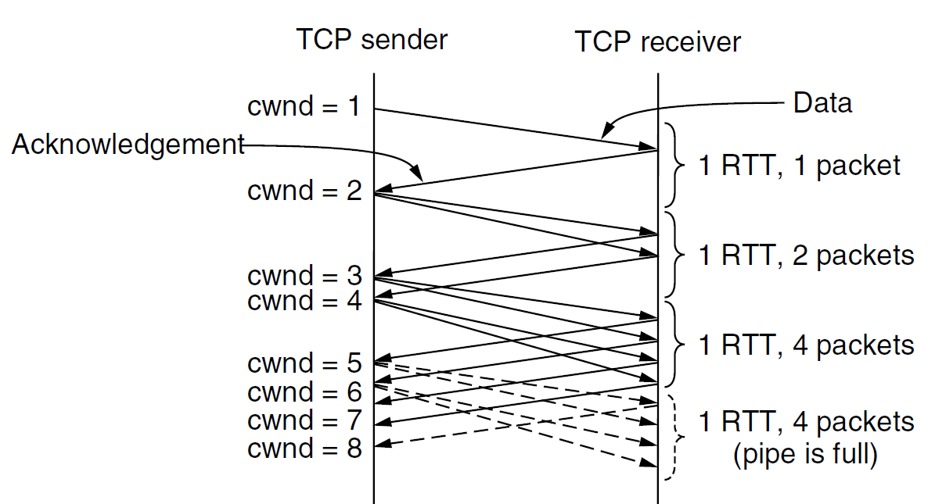
Slow Start from an Initial Congestion Window of One Segment

Slide 94
Slow Start Threshold
TCP connection maintains a threshold to keep slow start under control
Initially, set the threshold as the size of the flow control window, set cwin as 1 or 4 segments
TCP keeps increasing the cwin in slow start until a timeout occurs or the cwin exceeds the threshold
Whenever a packet loss is detected, the threshold is set to be half of the cwin and the process is restarted
Whenever the slow start threshold is crossed, TCP switches from slow start mode to additive increase mode

Slide 95
Additive Increase Mode
The cwin is increased by one segment every round-trip time
This is usually implemented with an increase after all segments in cwin is acknowledged
Call the maximum segment size MSS, an approximation is to increase cwnd by (MSS×MSS)/cwnd for each of the cwnd/MSS packets

Slide 96
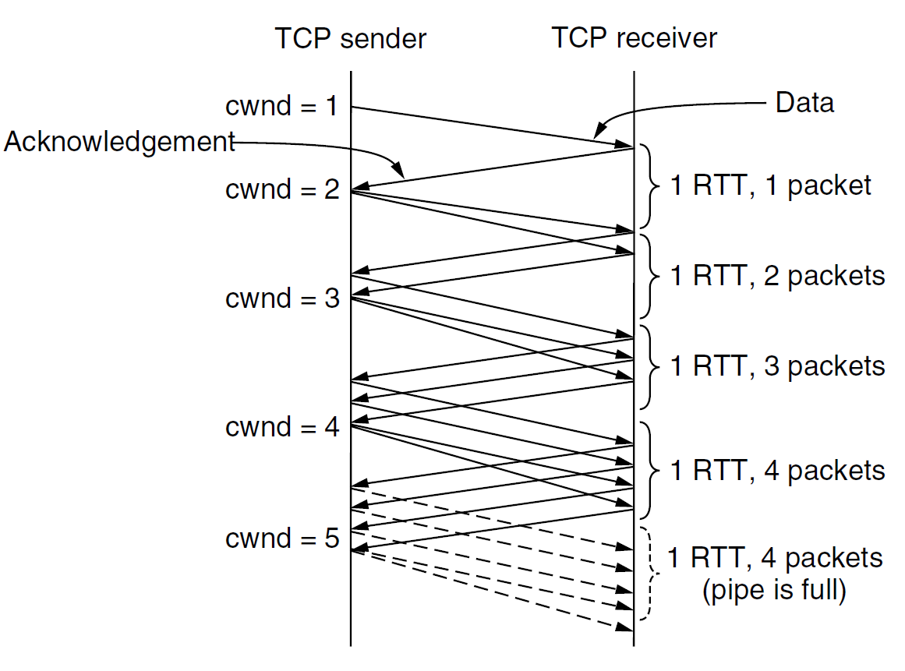
Additive Increase from an Initial Congestion Window of One Segment

Slide 97
Fast Retransmission
A quick way for the sender to recognize that one of its packets has been lost
As packets beyond the lost packet arrive at the receiver, they trigger ACKs. These ACKs have the same ACK number
If the sender receives a duplicate ACK, it is likely that another packet has arrived at the receiver. TCP assumes that 3 duplicate ACKs imply that a packet has been lost
This packet is retransmitted before timeout, the threshold is set to half of the current cwin, slow start can be restarted by setting the cwin to 1 segment (just as a timeout)

Slide 98
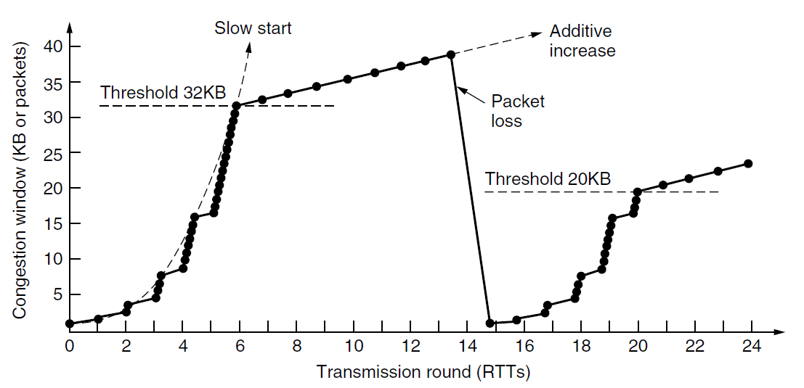
TCP Tahoe
Slow start followed by additive increase in TCP Tahoe

Slide 99
Fast Recovery
Avoid slow start
Set the new threshold as half of the current cwin at the time of the fast retransmission
Duplicate ACKs are counted until the number of packets in the network has fallen to the new threshold
From then on, a new packet can be sent for each duplicate ACK that is received
One RTT after, the lost packet has been ACKed, the stream of duplicate ACKs ceases and fast recovery mode is exited
Set cwin as the threshold and grows by linear increase (additive increase mode)
The upshot of fast-recovery algorithm
Avoids slow start, except when the connection is first started and when a timeout occurs
The cwin of a running connection follows a sawtooth pattern. That’s AIMD.

Slide 100
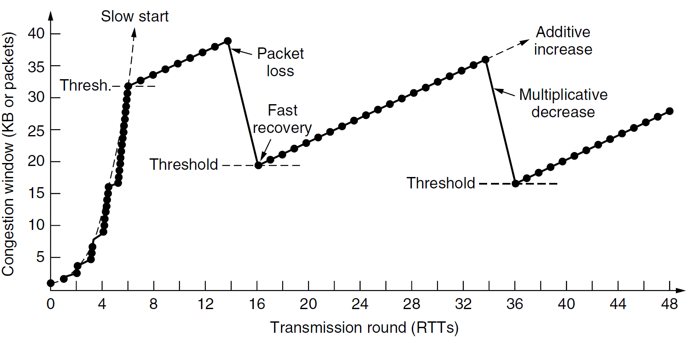
TCP Reno
Fast recovery and the sawtooth pattern of TCP Reno

Slide 101
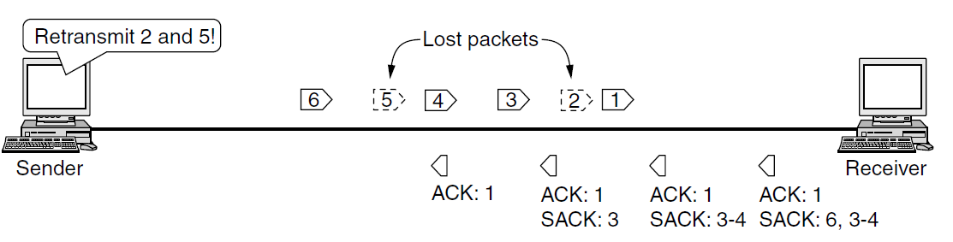
TCP option: SACK
SACK (Selective ACKnowledgements)
When TCP connection is set up, both the sender and receiver send the SACK permitted TCP option to signal that they understand SACK
SACK lists up to 3 ranges of bytes that have been received
(SACK is now widely deployed)

Slide 102
TCP option: ECN
ECN Option
ECN is enabled when both the sender and receiver indicate that they are capable of using ECN by setting the ECE and CWR bits during connection establishment
The TCP receiver is informed if any packet that arrives carries an ECN congestion signal, it then uses the ECE (ECN Echo) flag to signal the TCP sender
The sender tells the receiver that it has heard the signal by using the CWR (Congestion Window Reduced) flag
The sender reacts to these notifications in exactly the same way as it does to packet loss that is detected via duplicate ACKs (multiplicative decrease)
(ECN is an IP layer mechanism, it requires both host and router support and is not yet widely used on the Internet)

Slide 103
Various Implementations of TCP
TCP Tahoe (Van Jacobson, 1988)
TCP Reno (1990, 4.3 BSD) has formed the basis for TCP congestion control for more than two decades
Variants
NewReno: recovering from two or more losses in a window
Partial ACK: acknowledges some but not all of the packets that were outstanding at the start of Fast Recovery
Linux 2.6 uses a variant called CUBIC TCP
Windows includes a variant called Compound TCP
Selective ACK & TCP with ECN

